Slide 1
Analytics Primer
MGT 207 Production and Operations Management
Session 2

Slide 2
Today’s Plan
Linear Optimization (LP)
Integer Linear Optimization
Non-Linear Programming (NLP)
Simulation

Slide 3
Linear Optimization

Slide 4
What is Linear Program? (1/2)
A Linear Program (LP) is a mathematical optimization model in which
The objective function is a linear function of the decision variables, and
The constraints are given by limits on linear functions of the decision variables
Recall Production Mix Problem:
Decision Variables:
T = number of End Table to produce
S = number of Sofa to produce
C = number of chairs to produce

Slide 5
What is Linear Program? (2/2)
Production Mix Problem
Objective Function:
Maximize $300T+$400S+$200C
Constraints:
Lumber (feet): 10T+8S+3.5C ≤4600
Fabric (yards): 10S ≤2500
Saw lumber (hours): 0.5T+0.4S+0.4C ≤300
Cut Fabric (hours): 0.4S ≤150
Sand (hours): 0.4T+0.2S+0.5C ≤280
Stain (hours): 0.4T+0.3S+0.4C ≤200
Assemble (hours): 1T+2S+0.4C ≤700
Non-negativity: T, S, C ≥ 0
A linear function of T, S, C
Left hand:
linear functions of T, S, C

Slide 6
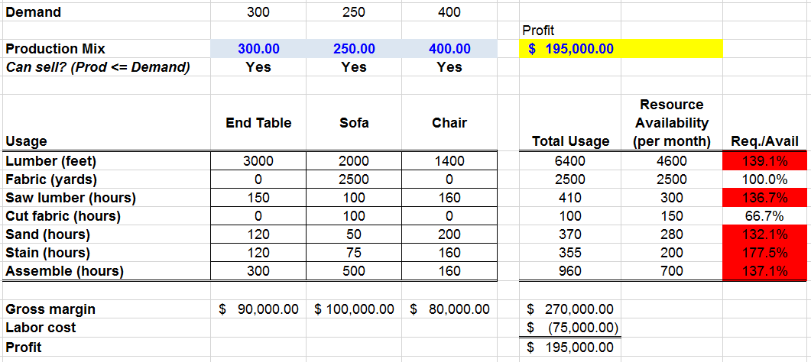
A Production Mix Problem: Capacities and Demand
Profit if there were no resource constraints
Production = demand
Gap!
What is the best feasible mix?

Slide 7
Heuristic Strategies Approach #1: Prioritize Production According to Margins
Obviously, it is important to take the contribution margins into account:
Table: $300, Sofa: $400, Chair: $200
Let’s suppose that we wanted to adopt a strict priority rule “S→T→C”
How many sofas can we produce and sell?
If you produce the above number of sofas, how many tables can be produced and sold with the remaining capacity?
Next, what about chairs?
What would be the profit under the above policy?

Slide 8
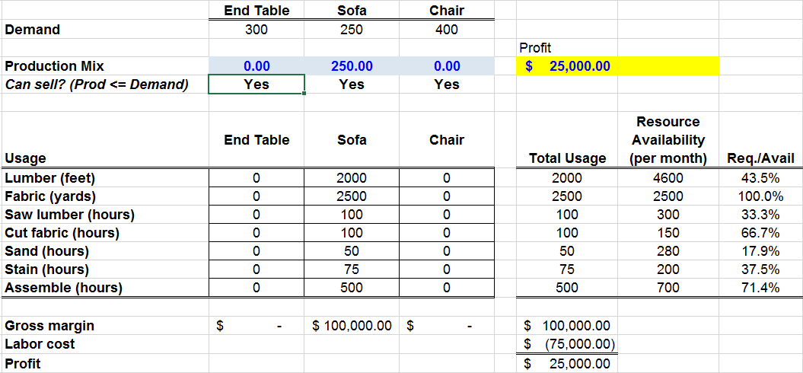
S→T→C Priority Rule

Slide 9
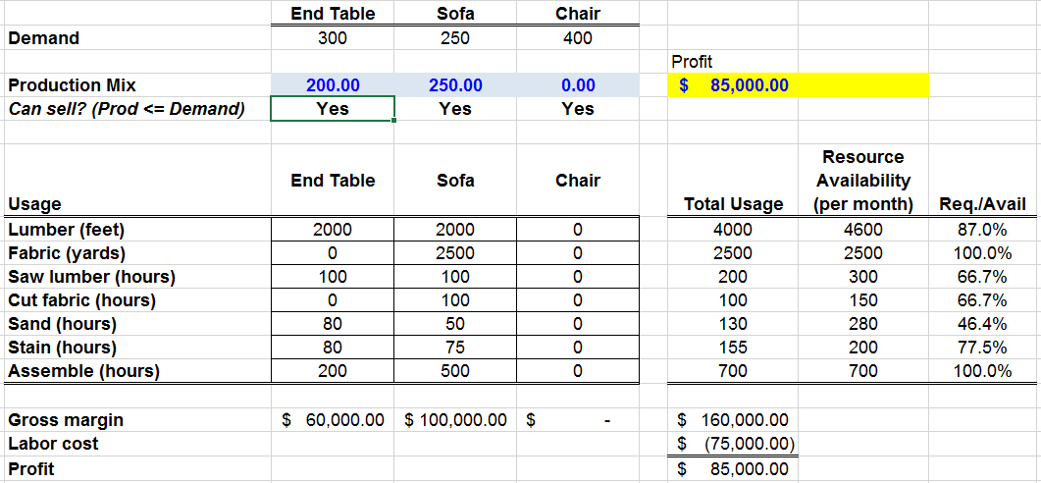
S→T→C Priority Rule
What is potentially wrong with this heuristic?

Slide 10
A Problem Statement
Given your limited resources, how would you allocate them in an optimal way, so as to maximize profit?
In fact, the production mix optimization problem
belongs to a class of problems called
Resource Allocation Problems

Slide 11
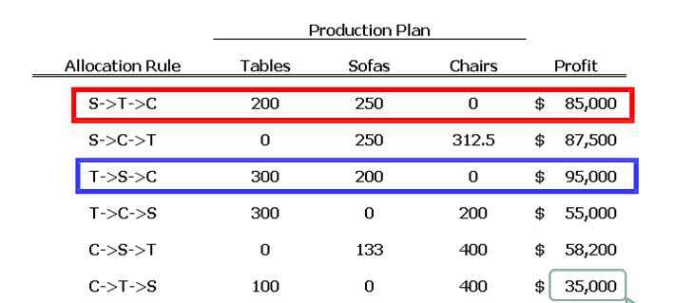
Heuristic Strategies: All 6 Sequential Allocations (“Strict Priority Rules”)
If we really can’t trust any simple approach to determining the best priority, should we try all possible strict priority rules?
What is a serious disadvantage of the approach of exhausting all possible sequential
allocations?

Slide 12
If you have 10 products: How many strict priority rules do you get?
Will one of these rules be optimal?

Slide 13
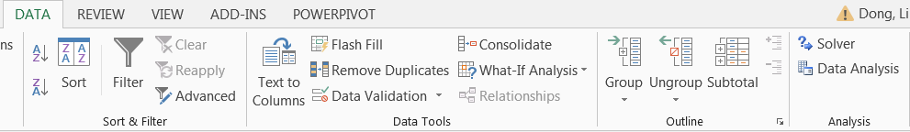
Introduction to Excel Solver
Solver
Excel 2013

Slide 14
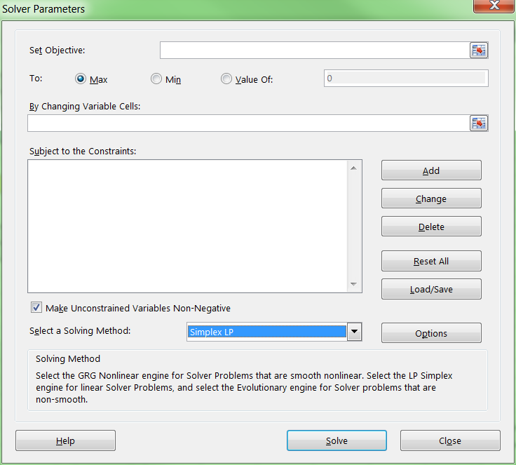
Using Excel Solver – The Solver Parameter Window
2. Max? Min?
1. Objective function
3. Decision Variables
5. Select if
decision variables
only take non-negative values
4. Constraints
6. Select “Simplex LP” if the problem is a Linear Program problem

Slide 15
Production Mix: Problem Statement
Objective function: Cell G23
– Maximize!
Decision variables: Cells C23:E23
– Should be non‐negative.
Constraints:
– Decision variables should be less or equal to the demands:
C23:E23 <= C21:E21
– Resource usages need to be lower or equal to available amount of resources:
G27:G33 <= H27:H33

Slide 16
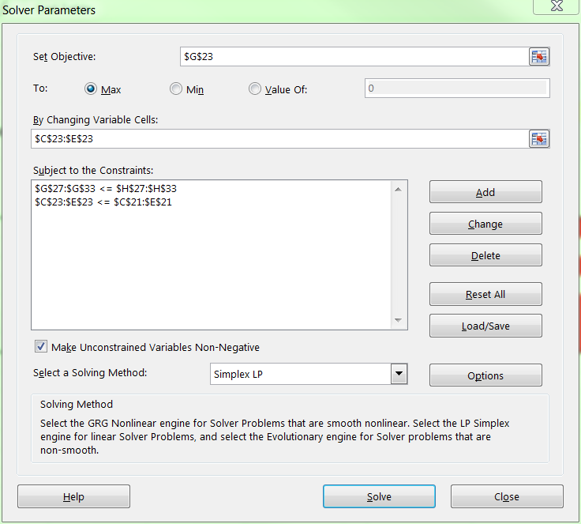
Using Excel Solver: The Solver Parameters Window
2. Max? Min?
1. Objective function
3. Decision Variables
5. Select if
decision variables
only takes non-negative values
4. Constraints
6. Select “Simplex LP” if the problem is a Linear Program problem

Slide 17
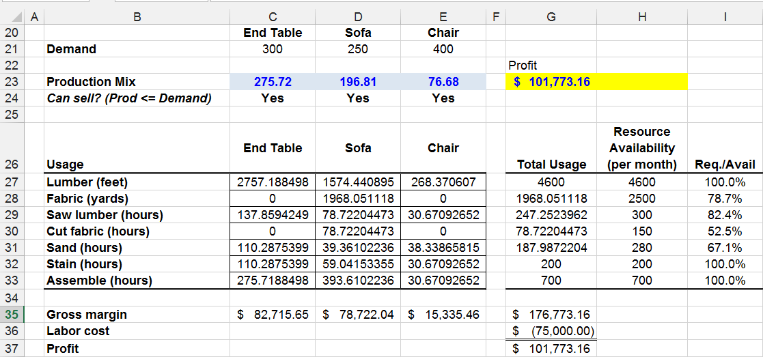
Production Mix Problem – Optimal Solution

Slide 18
Linear Integer Optimization

Slide 19
ILP: A Capital Budgeting Problem
Most corporations want to undertake projects that contribute the greatest net present value (NPV), subject to limited resources (usually capital and labor).
An example: a software development company is trying to determine which of 20 software projects it should undertake. The company cannot undertake a fraction of a software project.

Slide 20
Capital Budgeting Formulation
Model in Words
Model in Math
Decision variables:
Which projects to undertake
Decision variables: x_{i} , i = 1…,20
(x_{i} is a 0-1 binary variable)
Objective function:
Maximize NPV of project portfolio
maximize
Constraints:
Budget constraints for Year 1, 2,3
Labor constraints for Year 1, 2,3

Slide 21
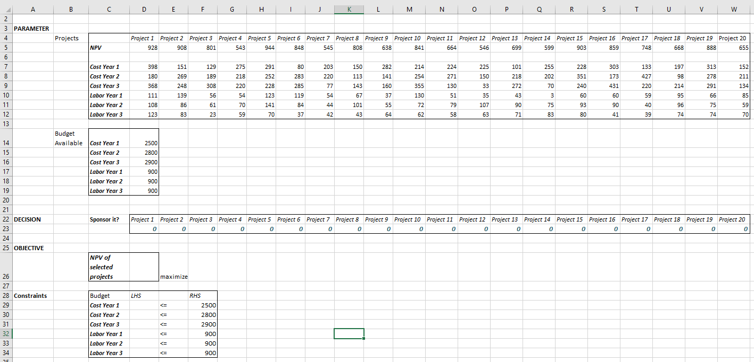
D26= SUMPRODUCT(D23:W23, D5:W5)
D29= SUMPRODUCT($D$23:$W$23,D7:W7)

Slide 22
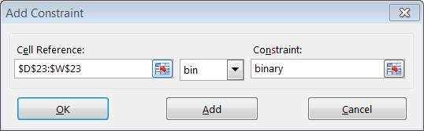
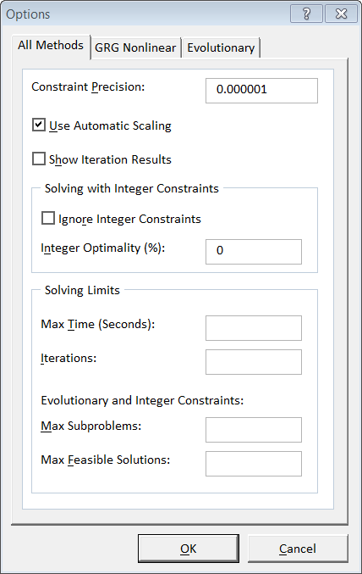
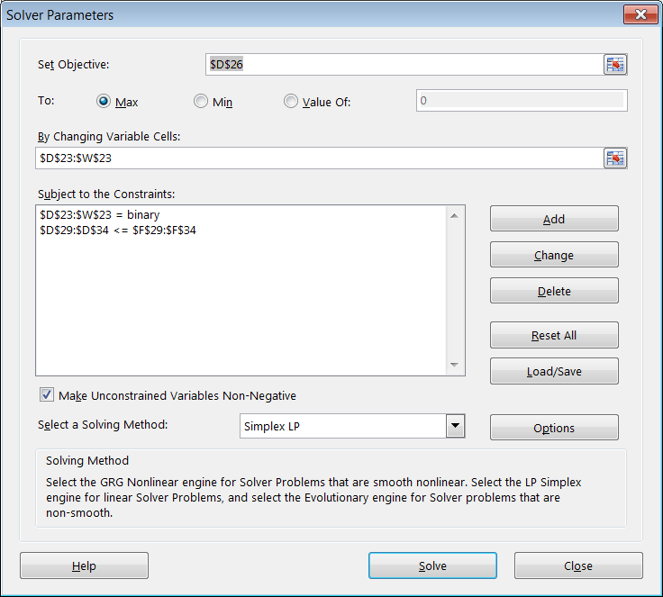
Solver Parameters
Enforce the binary requirement on project selection cells using “bin” in the “Add Constraint” dialog box
To guarantee an exact optimal solution, set “0” in the “Integer Optimality(%)” in the Solver Options dialog box (Solver may run a long time)

Slide 23
Add Additional Logical Constraints
Consider following situations
Project 6 and Project 7 cannot be selected together.
If project 1 is selected, the project 2 must be selected, and vice versa.
If we select Project 3, we must also select Project 4; but select Project 4 does not necessarily require selection of Project 3.
We can do at most four projects from among Projects 1 through 10.

Slide 24
Nonlinear Optimization

Slide 25
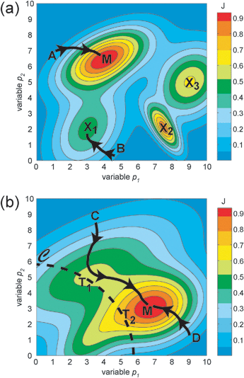
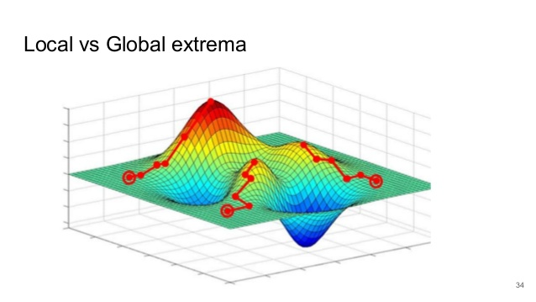
Illustration: Nonlinear Objective

Slide 26
Gradient Search
Gradient search: move in the direction of the largest improvement
A technique used by Solver for nonlinear optimization.
Idea: “Hill climbing in a fog.”
Try to follow steepest path going “up.”
After each step, or group of steps, again find steepest path and follow it.
Stop if no path leads “up.”
Some algorithms employ different types of improvements over the above procedure.

Slide 27
Example 4: A Profit Maximization Problem
Suppose that you wanted to purchase a product and sell it at your online store. You must order the product in advance (say, Q units) and you have space for up to 30 units only.
You can get the product for a price of $2 per unit. However, the supplier has a great deal going on, offering an all‐unit discount of 40%, if one buys 15 units or more.
In addition to the procurement decision, you need to set the price.
By policy, you want to limit yourself to a fixed price, that never changes.
A study you have conducted shows that in order to sell Q units, your price must be $4 ‐ $0.15*Q.
Example:
If you purchase 20 units, your cost would be 20*$2*60% = $24;
if you wanted to sell the 20 units, the price would have to be: $4 ‐ $0.15*20 = $1, and your revenue would be 20*$1 = $20. Consequently, your profit would be: $20‐$24 = ‐$4 (loss).

Slide 28
Mathematical Formulation
Construct an Excel spreadsheet model, and use Solver to determine the optimal value of Q.
Model setup
Decision variable: Q
Cost per unit: c = 2*IF(Q<15,100%,60%)
Sales price: p = 4 – 0.15*Q
Profit: π = Q*(p – c)

Slide 29
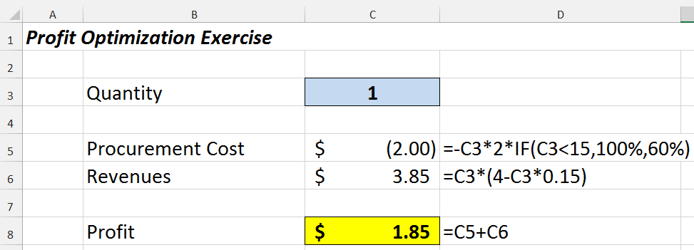
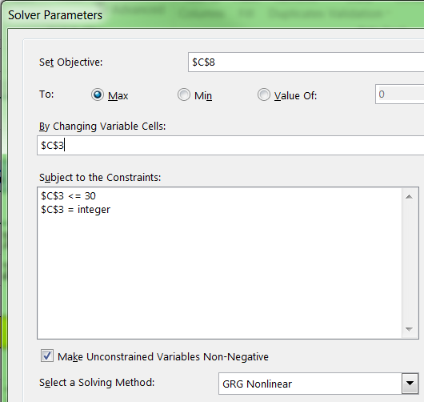
Solution via Solver – GRG Algorithm

Slide 30
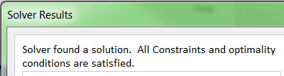
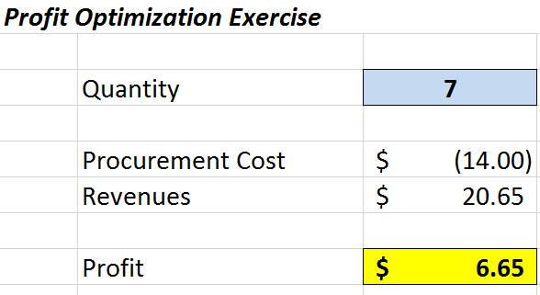
Solution via Solver

Slide 31
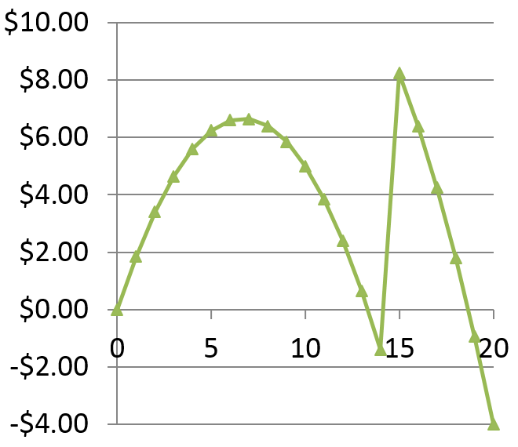
Profit as a Function of Quantity
Local optimal solution
$6.65
Global optimal solution

Slide 32
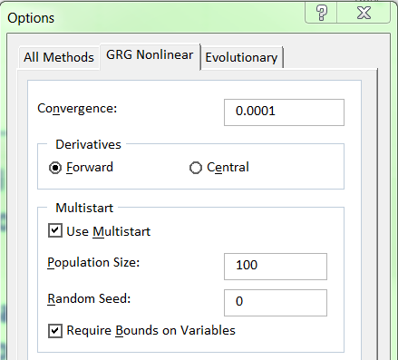
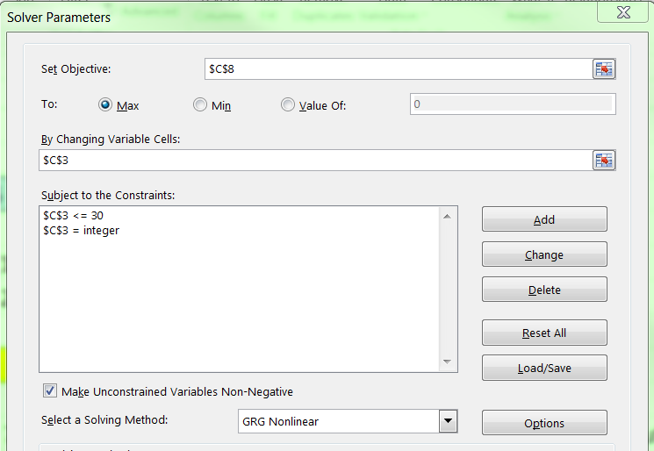
Lessons
Excel Solver can converge into a local optimum (i.e., a wrong answer), without any indication that something better can be achieved.
Using exhaustive search (going over all values of the decision variables) can lead to the optimal solution – but generally – a non‐practical approach!
Understanding of the context – hence making an educated guess – can help.
When you suspect multiple peaks and valleys exist, it is a good idea to use GRG Multistart, which tries multiple starting points and finds the best answer for each.

Slide 33
Simulation

Slide 34
What is simulation?
Simulation is the process of creating a model of a real-world scenario or system in order to study its behavior or characteristics
It essentially imitates the operation of a real-world process or system to understand how it functions or might react to different conditions
In business, we use simulations when there is randomness, e.g., randomness in payoffs
We utilize random generation in Excel

Slide 35

Simulating Values from Probability Distributions
Using Excel, it is easy to generate random numbers chosen from the range [0,1] with equal likelihood using (=RAND())

Slide 36
Simulating Values from Probability Distributions
Discrete Uniform Distribution: If all values between a lower limit a and a upper limit b are equally likely, but the variable is allowed to take on only integer values. The formula is:
For example, if we want integers between 0 and 99, we use =RANDBETWEEN(0,99)

Slide 37
Simulating Values from Probability Distributions
Normal Distribution: To simulate random numbers from a normal distribution with mean μ and standard deviation σ, we use the NORMINV function as follows:
For example =NORMINV(RAND(), 30,5) will generate a random number from a normal distribution with a mean of 30 and a standard deviation of 5.

Slide 38
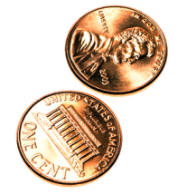
Let’s Gamble! Heads or Tails? Toss a coin
You pay any dollar amount to participate, then pick a side (heads or tails). If the side you picked shows up, you get double the amount (i.e., 100% gain); otherwise you get nothing (i.e., 100% loss).
You have $8 in your pocket.
Your strategy:
You play 3 rounds.
In the first round, you bet on one quarter of your money (that’s $2).
In the second part, you bet on one half of your available money (after gain/loss in previous round).
In the third part, you bet on the entire amount left in your pocket.

Slide 39
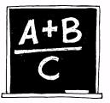
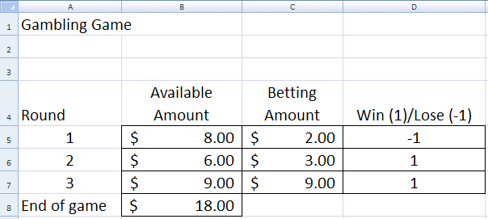
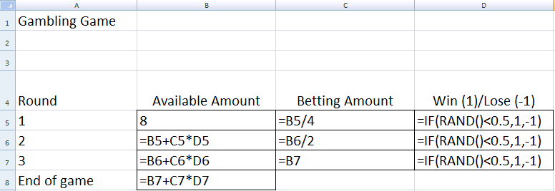
Model Setup
A sequential “investment” process
Note that values on this table change every time you change any cell content, or whenever you press F9.
These cells simulate the individual coin tosses

Slide 40

Statistical Profile of Outcomes Theoretical (Exact) Evaluation
In the latter example, it is possible to calculate the distribution of the end-of-game amount, by using probability theory:
1/2
$30
Bet on $15 out of $15
Toss #3
1/2
Bet on $5 out of $10
Toss #2
$0
1/2
1/2
1/2
$10
1/2
Bet on $5 out of $5
Toss #3
Win
Bet on $2 out of $8
Toss #1
$0
1/2
1/2
$18
Bet on $9 out of $9
Toss #3
1/2
Bet on $3 out of $6
Toss #2
1/2
1/2
$0
Lose
1/2
1/2
$6
Bet on $3 out of $3
Toss #3
1/2
$0

Slide 41
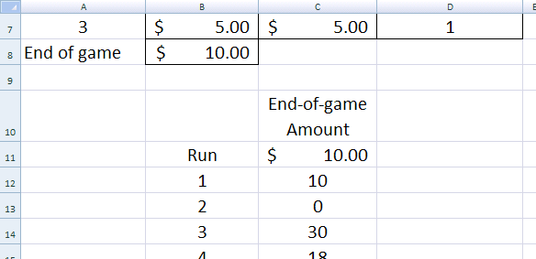
Statistical Profile of Outcomes Estimation via Simulation
The idea is very simple: “Press F9” (= run the model) many times, and keep track of the results (= metrics of interest).
A way to do this is via the Table function.
Step 1: Create a table with two columns: on the left column, type the title “run,” and the sequence of numbers “1, 2, 3, ....” (whatever number of runs you would like to have). On the second column you can type the name of the metric, and below that make a reference to the metric cell.
Description of metric
Reference to the metric cell =B8

Slide 42
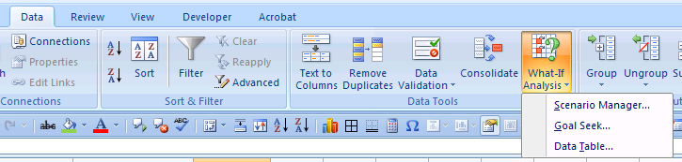
Estimation via Simulation (cont.)
Step 2: Highlight the table with the metric formula as the top line (in the example of the previous slide, cells B11:C11 form the top line), all the way to the last row that represents the number of runs (for instance, if we wanted to have 500 runs in the previous example, you would select cells B11:C511).
Step 3: Ask Excel to fill in the table.
1. Click on the Data tab
2. Click on the What-If Analysis button
3. Select Data Table

Slide 43
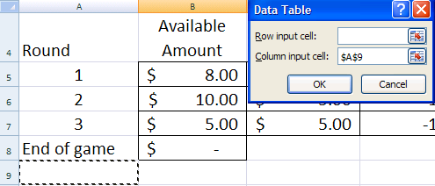
Estimation via Simulation (cont.)
Step 4: In the Data Table options, specify a reference to an empty cell! Then, click “OK.”
Step 5: You may want to copy and paste the table values to a different part of the spreadsheet, and then highlight the calculated numbers on the table (cells C12:C511 in the example above, right-click, and click on “Clear Contents” – this will delete the original table and save unnecessary time-consuming calculations (note that Excel recalculates active tables every time you make a change in any cell).

Slide 44
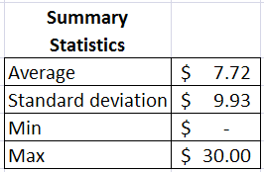
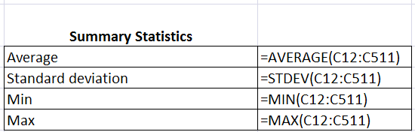
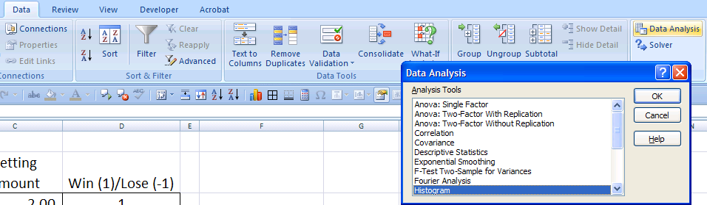
Estimation via Simulation (cont.)
Step 6: Calculating summary statistics
Step 7: A histogram shows the estimated distribution of the values that your metric (end-of-game amount, in our example) takes.
Formula Presentation
2. Click on the Data Analysis button
1. Click on the Data tab
3. Select Histogram

Slide 45

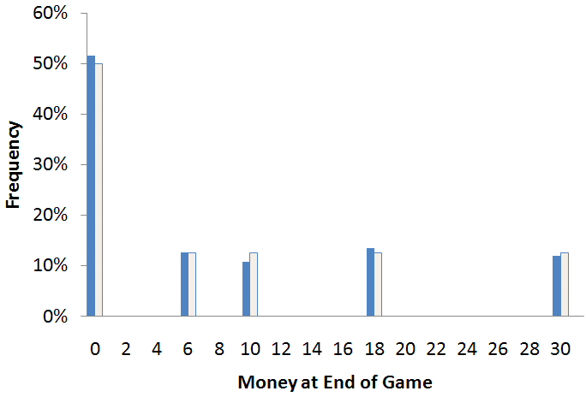
A Histogram of Outcomes
Left columns = statistical sampling (simulation)
Right columns = theoretical
Obviously, you are not expected to calculate the theoretical values. If you could do that, there would (generally) be no point in conducting a simulation.

Slide 46


Confidence Intervals (Level of confidence = 1 – α)
For sample means
For example, for 1-α = 95%, we get z-value = NORMSINV(0.5 + 0.95/2) = 1.96
Also, if n = 100, then m = 7.94; s = 10.96, then
7.94 - 1.96 × (10.96/√100) ≤ μ ≤ 7.94 + 1.96 × (10.96/√100)
7.94 – 5.79 ≤ μ ≤ 7.94 + 5.79
2.15 ≤ μ ≤ 13.73

